Slide 1
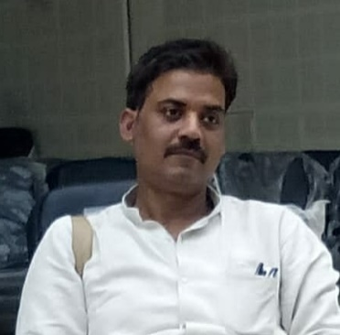
Godhan Allied Products and Services Pvt. Ltd. Rakesh Mishra Chief Executive Officer
Programme Name: NAVODAYA
Project Title: Green Fodder availability for state sponsored cattle shed units
Focus Area: Animal feed industry/ Feed technology planning and production
Scalability, large scale employment generation, sustainable development
Engaging and Handholding Support for Rural Stakeholders
Applicant Photo
Company Establishment Year:2024
Location of the Company: Kanpur
DIPP No: 187685
B.Tech. Master of Extension and Rural Development
Lab to Land Scholar

Slide 2

Green Fodder availability for state sponsored cattle shed units
Godhan Allied Products and Services Pvt. Ltd. Is Incubated at CSJM University Kanpur
Engaged in Activity based training and facilitation engaging NGO units and SHGs.
Engaging and Handholding Support for Rural Stakeholders
Expertise, Project Management and Marketing support for FPOs and other Producer groups
Supporting govt. implementation agencies offering schemes and policy components
Scalability, large scale employment generation, sustainable development

Slide 3

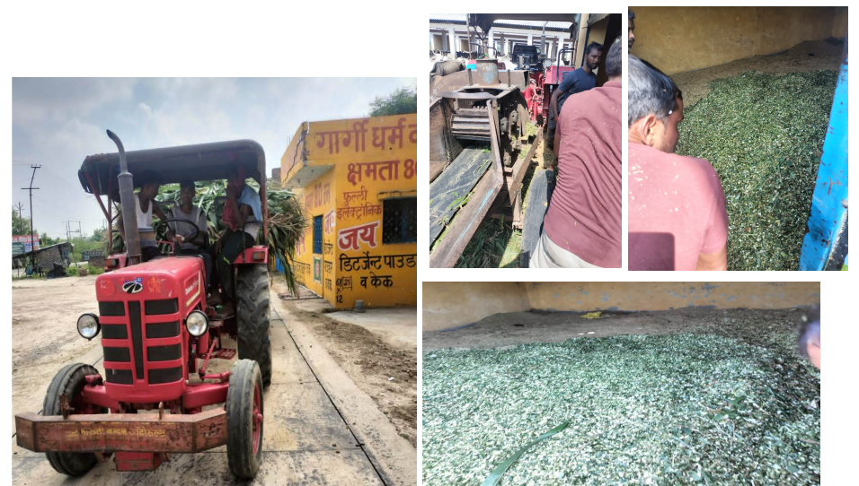
Godhan Allied Products and Services Pvt. Ltd.
Add your logo here
Green Fodder availability for state sponsored cattle shed units
Problem Statement
There is a challenge to ensure the resource management on the grass root level for cattle and cattle sheds.
Focus Area
Cattle Shed Management for State Sponsored cattle shed units
Add a high resolution photo of your product or service here
Tech Brief
Integrating natural and human resources using IOT and Block chain technologies
Founded In
2024
Location
Kanpur
2
FPO On board
2
Cattle sheds
Unique Selling Proposition
Scalable and priority area
Regional Resource Management
Community Engagement for large scale employment
2
Collaborated with HEI
5
SHGs on boarded

Slide 4
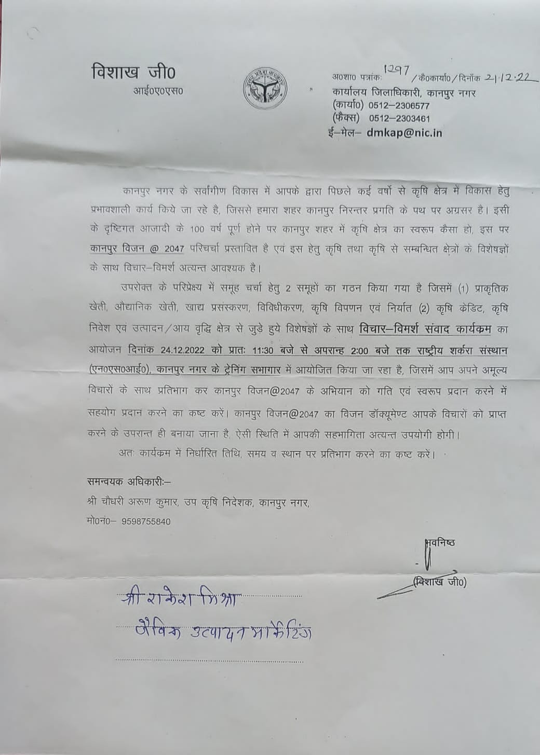
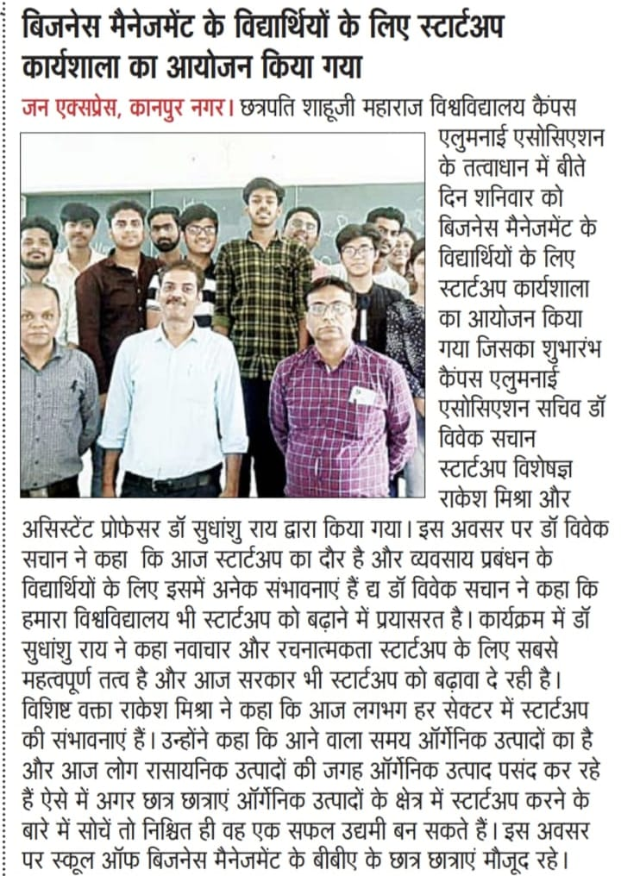
Community engagement
Received a letter of appreciation and invitation by Hon. District Magistrate for a discussion at National Sugar Institute as Expert in Organic Food Busines

Slide 5
Tech Validation, IP & Field Trials
Intellectual property regarding our project is under mentorship of CSJMU University. We hope to get help from higher academic institutions like IVRI to evaluate for IPR related aspects.
Mention patents & IP strategy, not yet
Technology validation: We are collaborating with School of Advanced Agricultural Sciences and Technology CSJM University for Technology development, validation
Fodder supply is worked out from field to cattle shed unit including community involvement.
Pradhan Sammelan organized at CSJMU 3 March 2018
https://youtu.be/L8s5dm5Ygcw
How to Connect Gaushalas with Self Help Groups : Start Up Conclave
https://www.youtube.com/watch?v=0byX-_0Jvgo
Village Meeting Ganga Barrage Shankarpur Sarai Ganga Katari
https://www.youtube.com/watch?v=WLRsM82ibdE

Slide 6
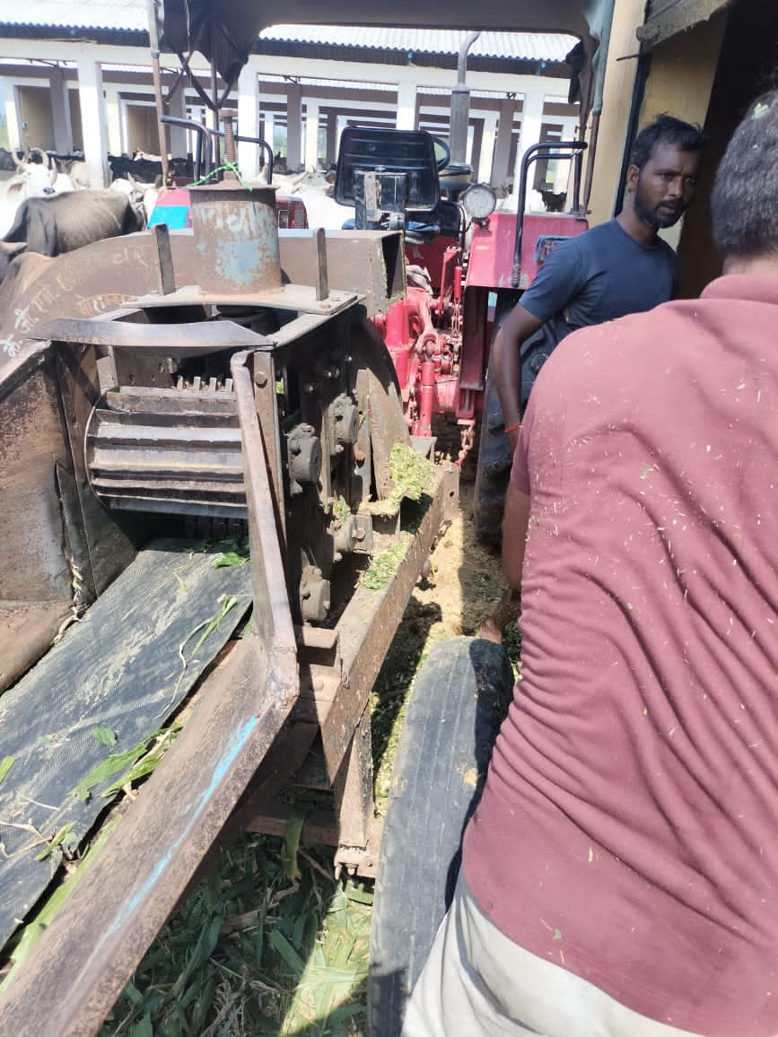
Cattle feed Supply: Green Fodder Chopping and Supply at Gaushala Village: Khodhan Block: Shivrajpur District: Kanpur Nagar

Slide 7
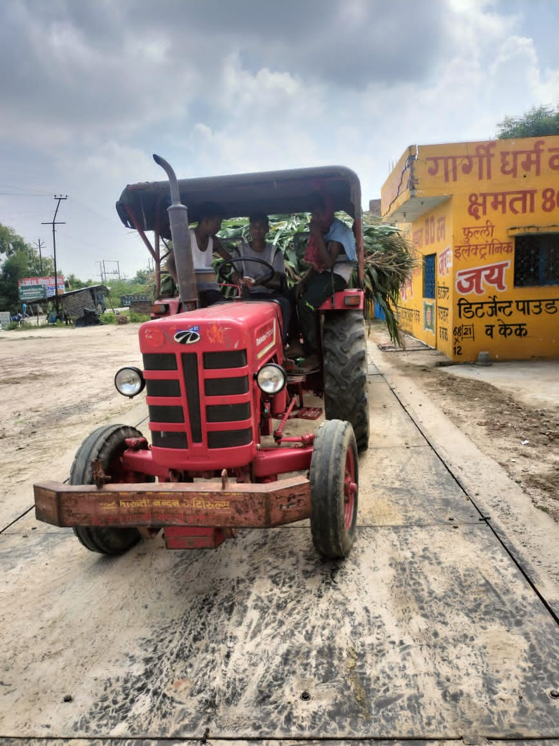
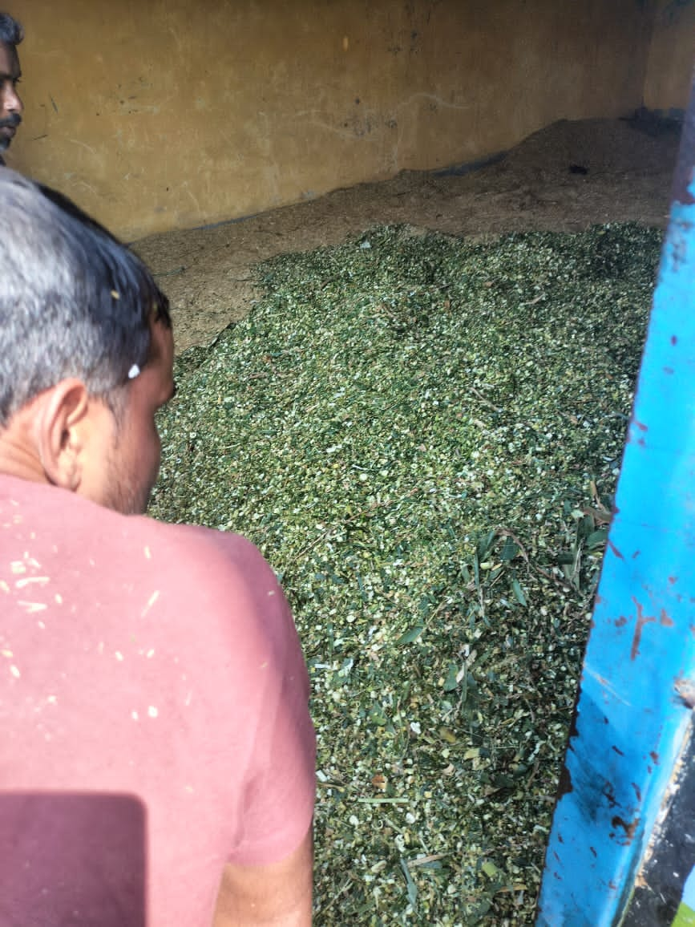
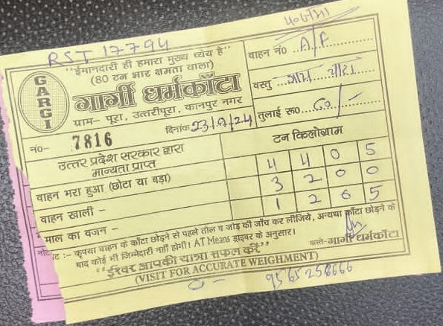

Slide 8
Progress in Last 3 Months
Last three months:
1. Mature understanding of the cattle shed management.
Designed a in house training facility of local Self help groups in association with School of Advanced Agriculture Technologies Chhatrapati Shahuji Maharaj University Kanpur
Developed mature understanding with a CBG plant with a capacity of 100 TPD to utilize cow dung and horticulture waste working over signing a MoU for mutual benefits.
Developed mature understanding with a silage manufacturing unit with a capacity of 40 TON
Cattle shed unit pilot project to be finalized to under take in association with a NGO
A consent letter received by a FPO for association with cattle shed units.

Slide 9
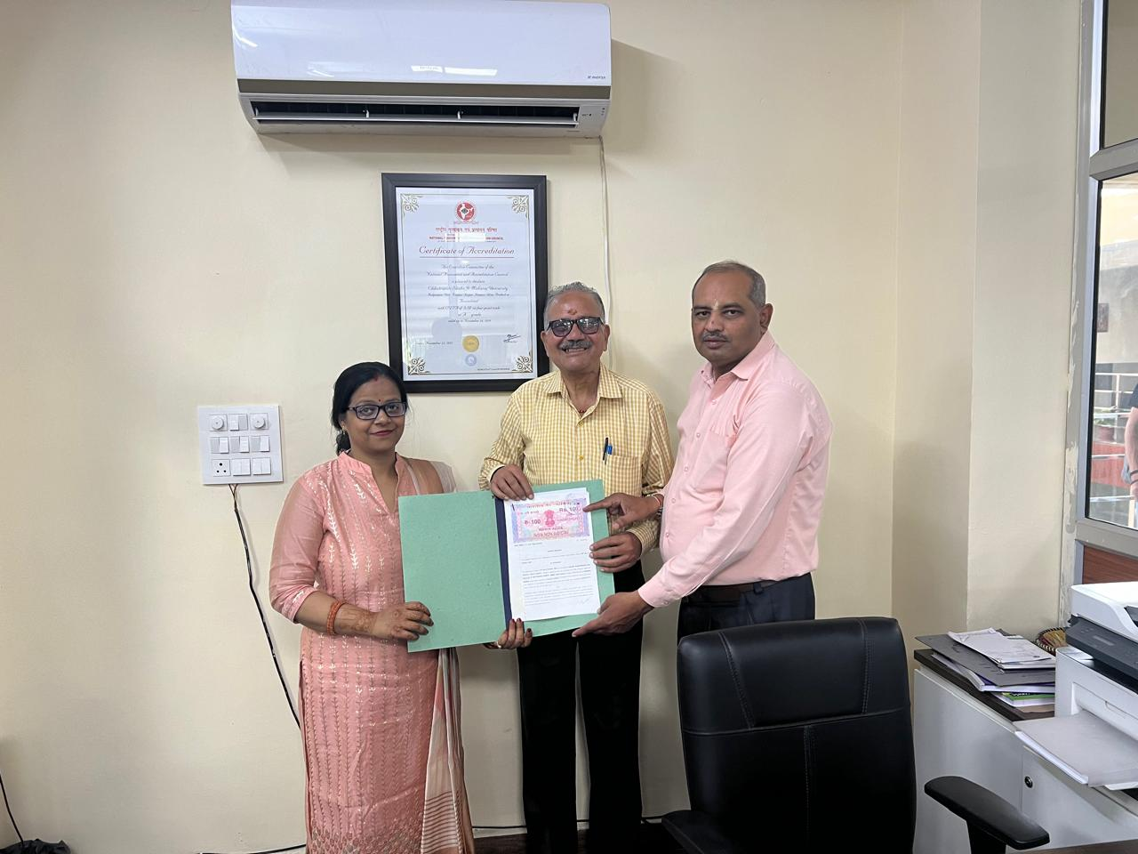
Incubation agreement signed by Pranoti Mishra, Director Godhan Allied Products and Services Pvt. Ltd.
Incubated at CSJMIF, Chhatrapati Shahuji Maharaj University, Kanpur

Slide 10
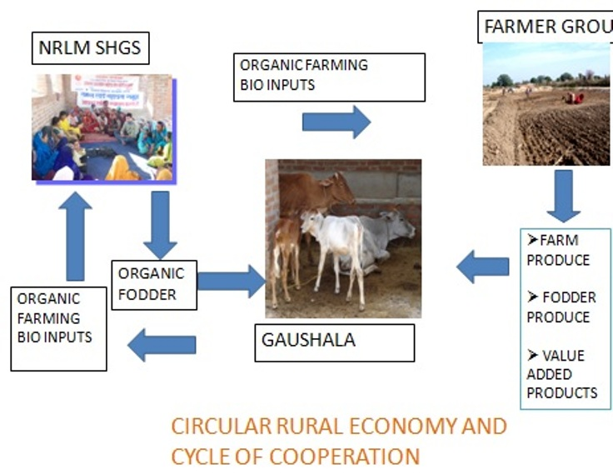
Revenue
Business Model
Engaging the communities creates huge opportunities for employment as well as enterprise of the local communities.
It can be further connected with the market with Quality products and services including farms and cattle shed units.
Our approach is to partner with RSETIs, expert groups and professionals.
Altogether we are working in domains of project management and marketing services for organic farming groups and FPOs.
In order to support the farming communities we offer our marketing and project management services for business development of local communities. That’s how We are following VOCAL for LOCAL.
Quality improvement, technology upgrades, water management, crop level business activities are next avenues of resources generation.

Slide 11
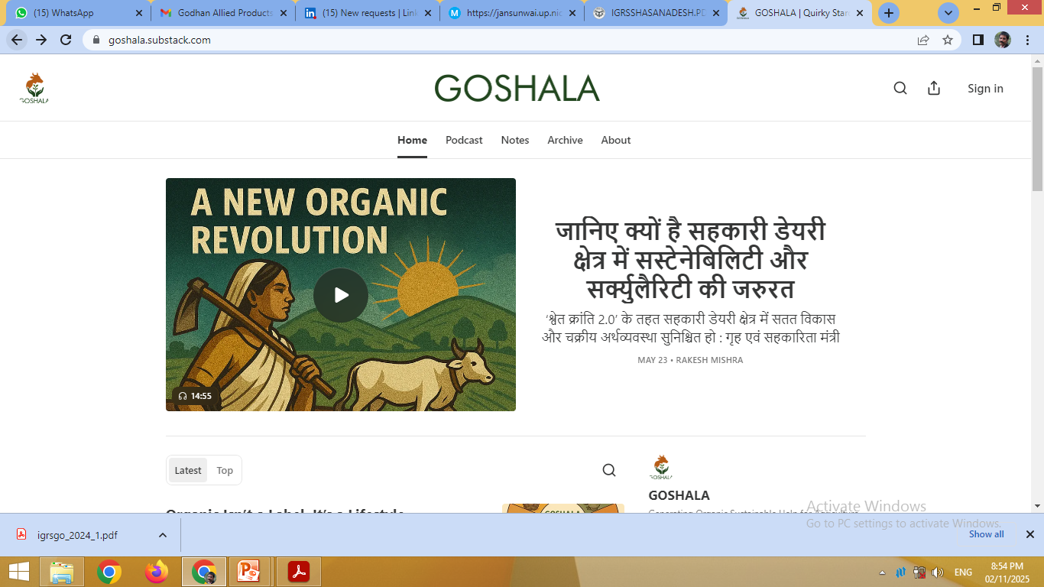
Marketing
Case UP: Cattle, cattle sheds and SHGs
Numbers at a glance…
Number of State Sponsored Cattle sheds: 7000
Number of Cattle accommodated: 1200000
Number of people listed into SHGs : 3.5 crores
Average Expense per cattle per day: Rs. 50/-
Care taker deployed : per capita 25 cattle (Approx)
Potential additional deployment : 50000 nos.
Potential self employment : 200000 nos.
https://goshala.substack.com/p/be8
Our business model is B2G with focus on community engagement.
Creating awareness for Compliances and policies among Self Help Groups Groups and FPOs as producer and service provider
Development of a website with special focus on block chain and green fodder management for cattle shed units and organic farmers.
Large number of farmers are suffering from the chaos of stray cattle as well as the cattle itself require sustainable solution. This situation lead by state government concluded into more than 6000 cattle shed based shelter. That's how a huge infrastructure is created all across the Uttar Pradesh. This organised system has bred number of opportunities for local communities. All along with the opportunities thousands of farmers are supported by the government to cultivate organic farm produce. Thousands of hectare farmland are planned to be converted into organic farms. All these opportunities need to be integrated into ecosystem of self employment.

Slide 12
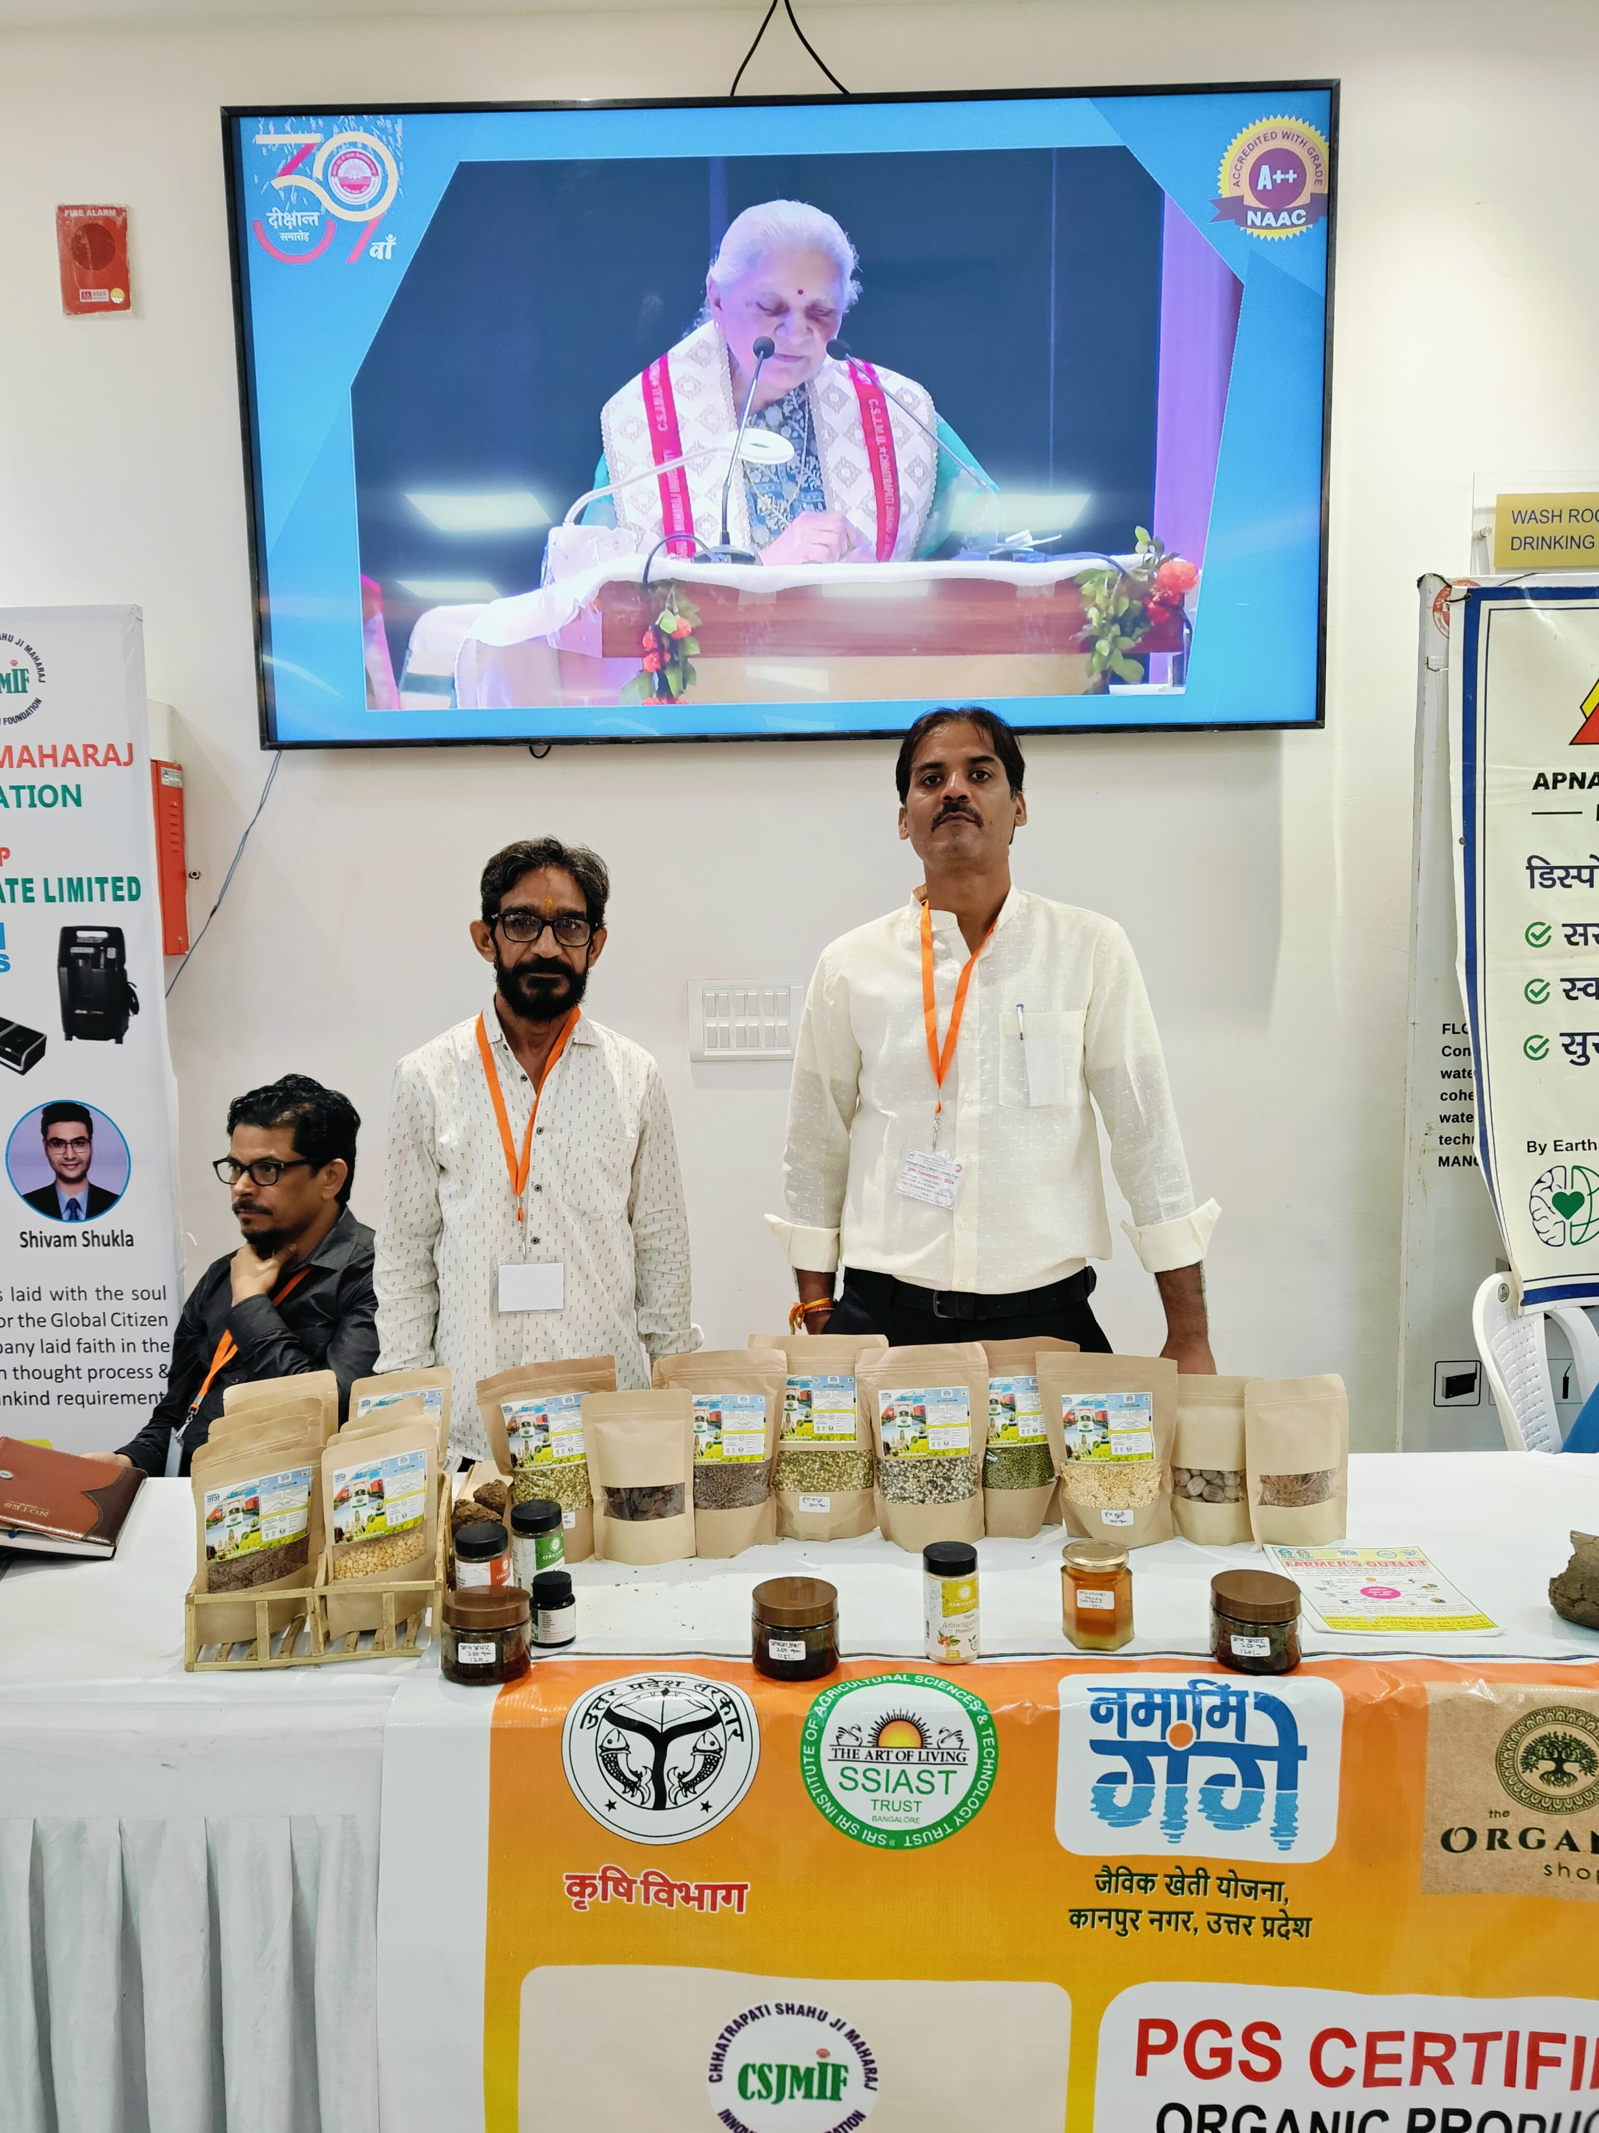

Demonstrating Organic Food Products at CSJM University in alliance with associates

Slide 13
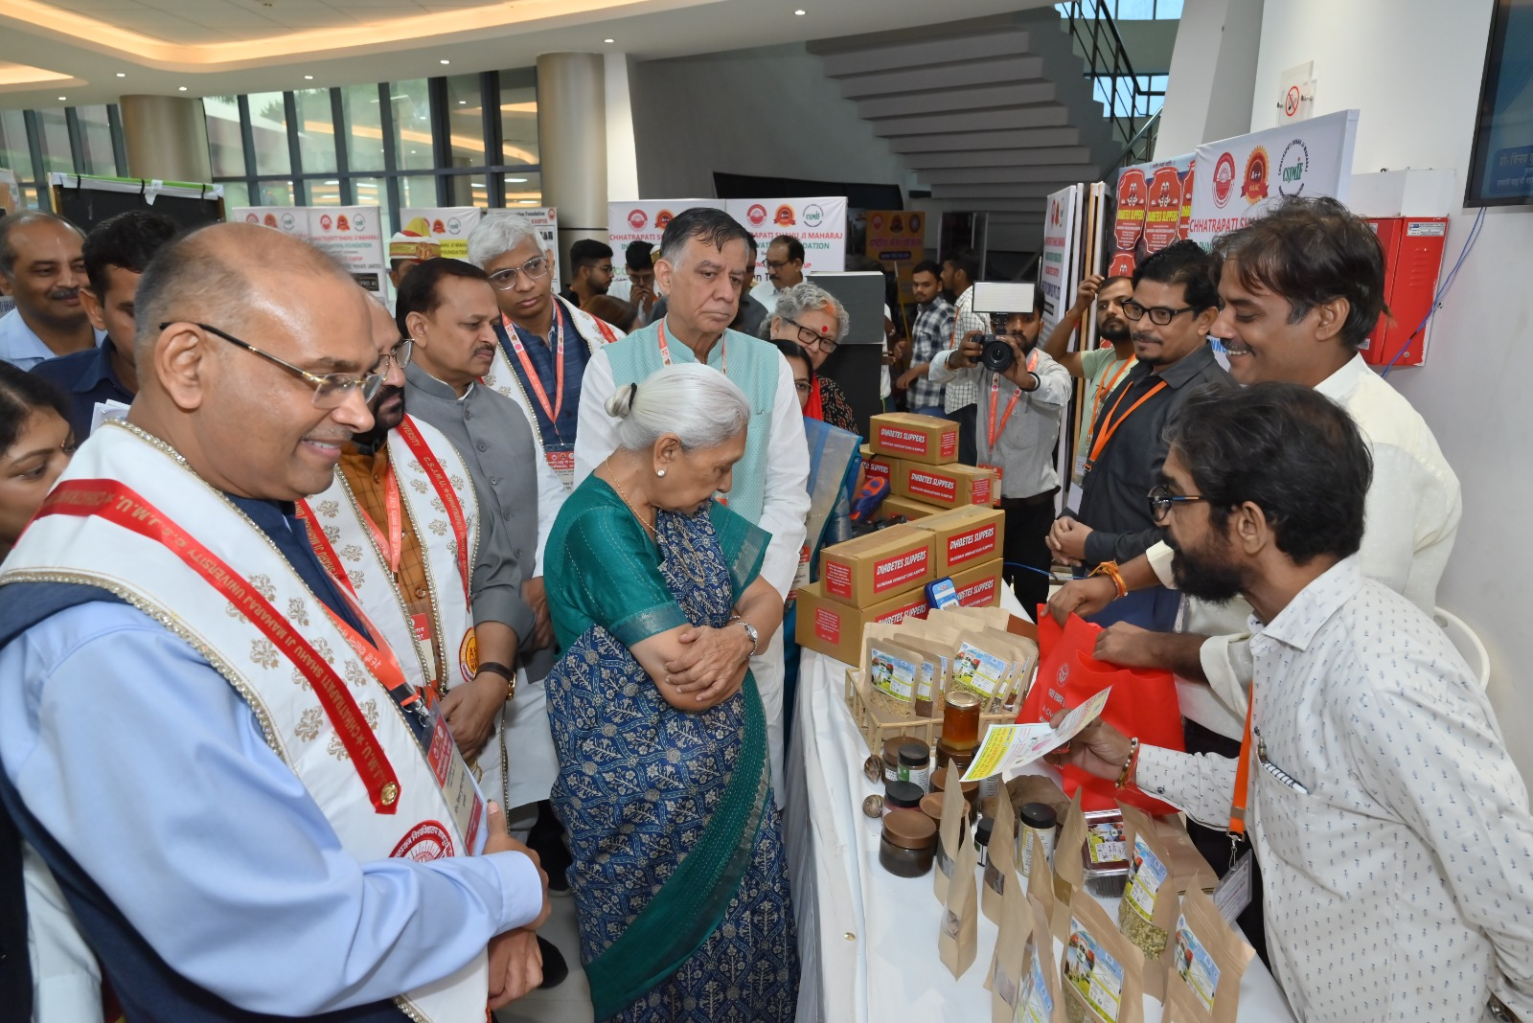
At Convocation Inspected and oblidged with grace of Honourable dignitiaries including honourable: Governor UP Vice Chancellor CSJM University, Director AICTE, MP from Kanpur, Speaker UP State Assembly, Minister Higher Education, UP Mayor from Kanpur DM Kanpur CDO from Kanpur

Slide 14
Milestones & Timelines
Milestone | Action Point | Term 1
Infrastructure Development | To develop the online web portal
 | To Purchase 01 unit chopper
Team Building | To hire 02 full time operational executives
 | To hire 2-3 interns for technical and marketing work
Marketing, trails and R&D | To test the final green fodder product from the recognized lab/university/institute
 | To conduct the meeting in the different villages | 12-15
 | To onboard the farmer for the raw material | 50-70
 | To onboard the SHGs/FPOs for networking and promotion | 2-4
 | To participate and attend the Krishi Mela/Event | 3-5
Business development | To sale the final product (in tons) | 250-300

Slide 15
Funds Utilization
Heads | Term 1 (100%) | Total (Amount) | Total (%) | Owner’s Contribution (15%)
Capital Expenditure | 1.25 | 1.25 | 25
Working Capital | 1.00 | 1.00 | 20
Marketing, Trials, R&D | 1.25 | 1.25 | 25 | 0.20
Manpower | 1.50 | 1.50 | 30 | 0.60
Contingency | 0 | 0 | 0
Grand Total | 5 | 5 | 100% | 0.80 (16%)

Slide 16
Fund Raised by startups (Rs. Lakh)
Government Source:-
Grant-in-aid (Rs: Lakh) 0
Price Money (Rs: Lakh) 0
Equity fund from Govt (Rs: Lakh) 0
Private Source of Funds:-
Equity Fund(Rs: Lakh) 100000
Debt (Rs: Lakh) 30000
Other funds (Stock) 200000

Slide 17
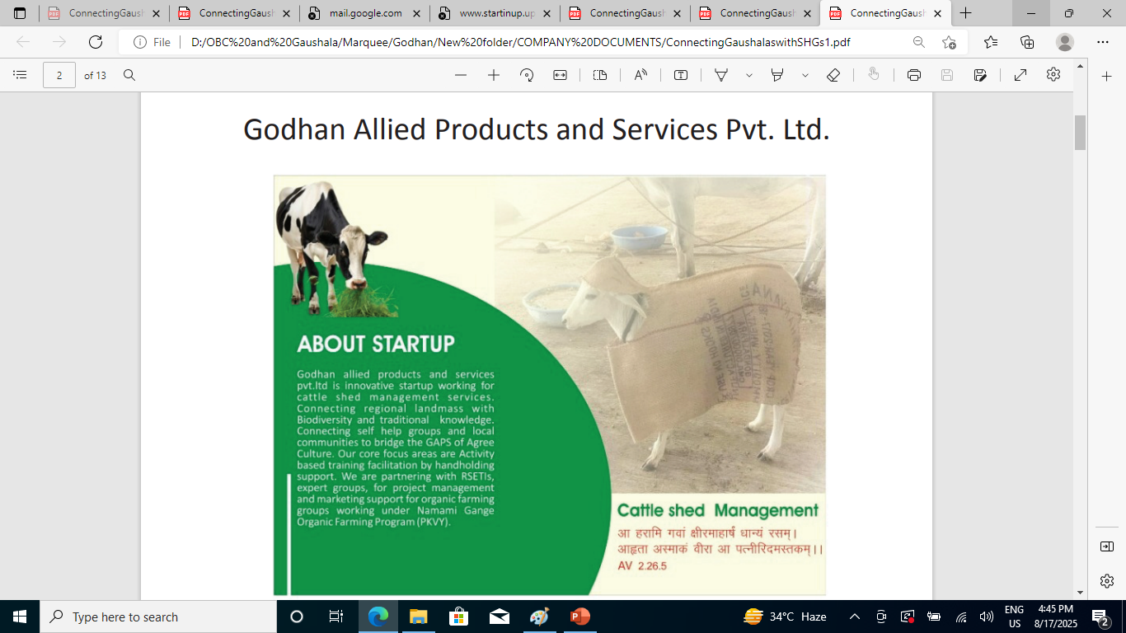

Thank
you.

Slide 18
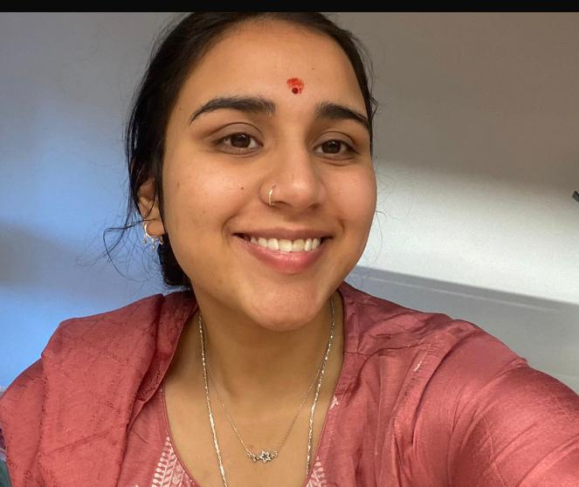
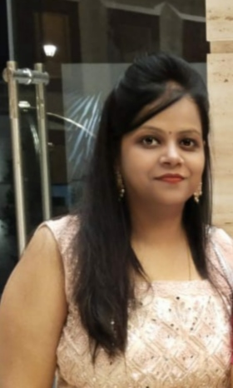
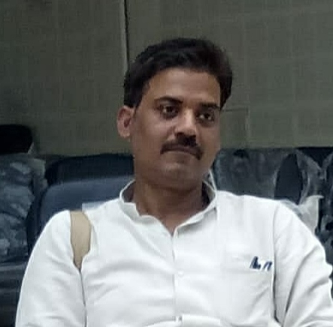
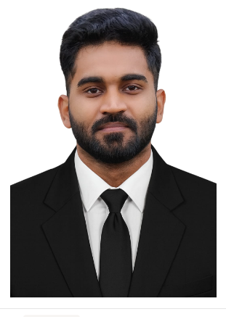
Team
Pranoti Mishra
Director
B. Tech, Master of Extension and Rural Development
Rakesh
Chief Executive Officer
B. Tech, Master of Extension and Rural Development
Utkarsh
Associate Legal and Financial
LLB
Entrepreneur
Kalyani Vatsala
Director
Graduate in performing arts, Mental Health Professional
Contact:
Godhan Allied Products and Services Pvt. Ltd.
8/87 Arya Nagar Kanpur-208002
E-mail: godhanbharat@gmail.com
Mobile: 6392740318

